Slide 1
Number Systems, Codes & representation of Signed Numbers

Slide 2
Number Systems
Decimal
Binary
Hexadecimal
Octal

Slide 3
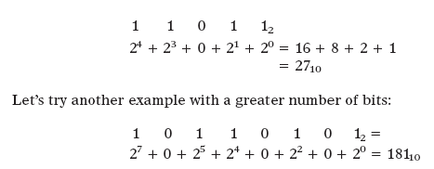
2-1 BINARY-TO-DECIMAL CONVERSIONS
Any binary number can be converted to its decimal equivalent simply by summing together the weights of the various positions in the binary number that contain a 1.To illustrate, let’s change 110112 to its decimal equivalent.

Slide 4
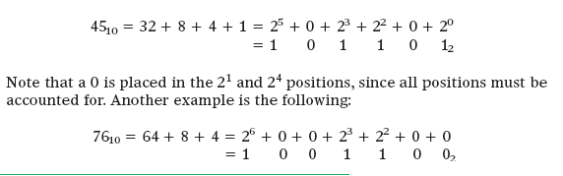
2-2 DECIMAL-TO-BINARY CONVERSIONS
There are two ways to convert a decimal whole number to its equivalent binary-system representation. The first method is the reverse of the process described in Section 2-1. The decimal number is simply expressed as a sum of powers of 2, and then 1s and 0s are written in the appropriate bit positions.
1st Method:

Slide 5
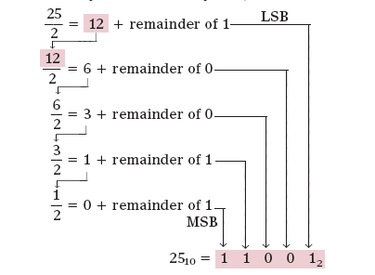
2nd Method-Repeated Division

Slide 6


EXAMPLE 2-2
(a) What is the total range of decimal values that can be represented in eight bits?
(b) How many bits are needed to represent decimal values ranging from 0 to 12,500?

Slide 7
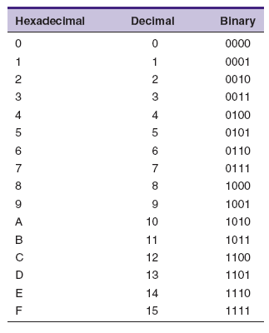
2-3 HEXADECIMAL NUMBER SYSTEM

Slide 8
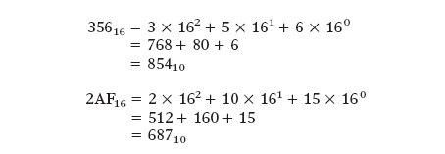
Hex-to-Decimal Conversion
A hex number can be converted to its decimal equivalent by using the fact that each hex digit position has a weight that is a power of 16.
Note that in the second example, the value 10 was substituted for A and the value 15 for F in the conversion to decimal.
For practice, verify that 1BC216 is equal to 710610.

Slide 9
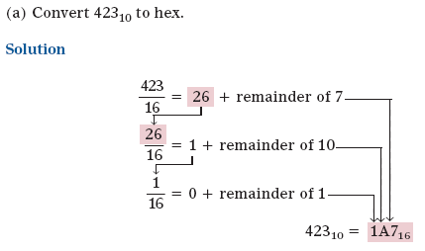
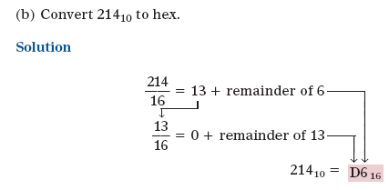
Decimal-to-Hex Conversion
Example: 2-3

Slide 10
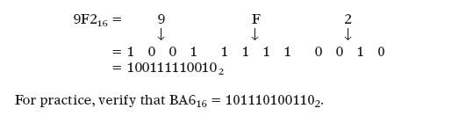
Hex-to-Binary Conversion
The hexadecimal number system is used primarily as a “shorthand” method for representing binary numbers. It is a relatively simple matter to convert a hex number to binary. Each hex digit is converted to its four-bit binary equivalent (Table 2-1). This is illustrated below for 9F216.

Slide 11

Binary-to-Hex Conversion
Conversion from binary to hex is just the reverse of the process above. The binary number is grouped into groups of four bits, and each group is converted to its equivalent hex digit. Zeros (shown shaded) are added, as needed, to complete a four-bit group.

Slide 12
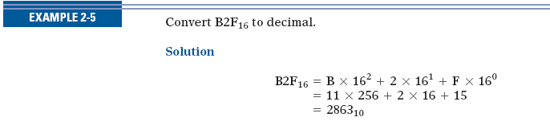

Slide 13

6-1 BINARY ADDITION
The addition of two binary numbers is performed in exactly the same manner as the addition of decimal numbers.

Slide 14
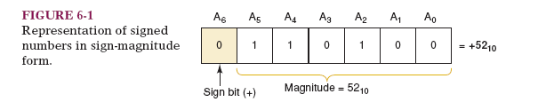
6-2 REPRESENTING SIGNED NUMBERS
The sign bit is used to indicate the positive or negative nature of the stored binary number. The numbers in Figure 6-1 consist of a sign bit and six magnitude bits. The magnitude bits are the true binary equivalent of the decimal value being represented. This is called the sign-magnitude system for representing signed binary numbers.

Slide 15
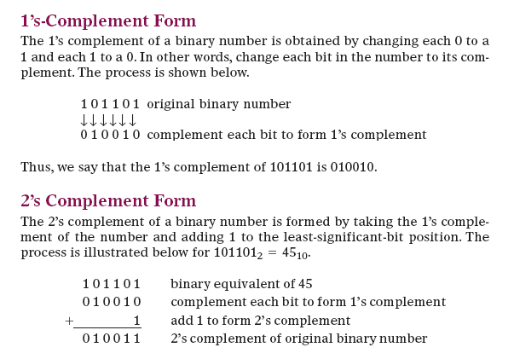
6-2 REPRESENTING SIGNED NUMBERS

Slide 16
Representing Signed Numbers Using 2’s Complement. The 2’s-complement system for representing signed numbers works like this:
■ If the number is positive, the magnitude is represented in its true binary form, and a sign bit of 0 is placed in front of the MSB. This is shown in Figure 6-2 for +45
■ If the number is negative, the magnitude is represented in its 2’scomplement form, and a sign bit of 1 is placed in front of the MSB. This is shown in Figure 6-2 for -45.

Slide 17
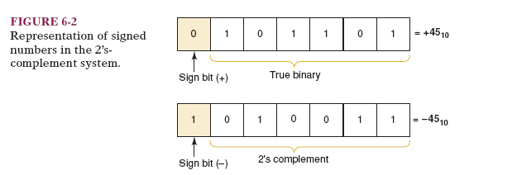

Slide 18
The 2’s-complement system is used to represent signed numbers because, as we shall see, it allows us to perform the operation of subtraction by actually performing addition. This is significant because it means that a digital computer can use the same circuitry both to add and to subtract, thereby realizing a saving in hardware.

Slide 19
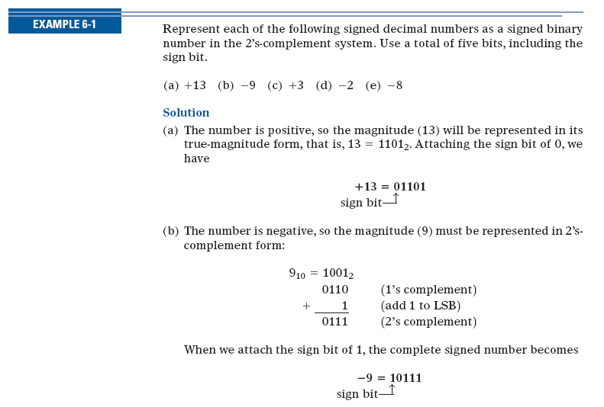

Slide 20
2-4 BCD Code
Binary Coded Decimal (BCD) is a widely used way to present decimal numbers in binary form.
Combines features of both decimal and binary systems.
Each digit is converted to a binary equivalent.
BCD is not a number system.
It is a decimal number with each digit encoded to its binary equivalent.
A BCD number is not the same as a straight binary number.
The primary advantage of BCD is the relative ease of converting to and from decimal.

Slide 21
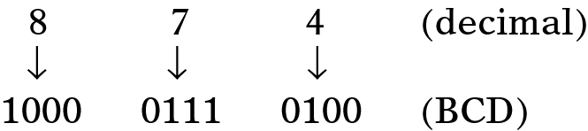
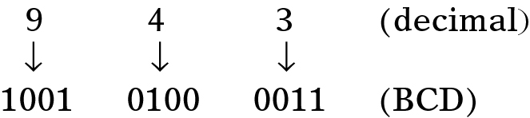
2-4 BCD Code
Ronald Tocci/Neal Widmer/Gregory Moss Digital Systems: Principles and Applications, 10e

Slide 22
Reverse the process to convert BCD to decimal.
Convert the number 874₁₀ to BCD:
Each decimal digit is represented using 4 bits.
Each 4-bit group can never be greater than 9.

Slide 23
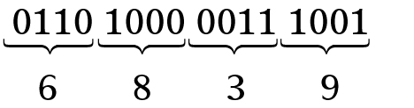
Convert 0110100000111001 (BCD) to its decimal equivalent.
Divide the BCD number into four-bit groups and convert each to decimal.
Ronald Tocci/Neal Widmer/Gregory Moss Digital Systems: Principles and Applications, 10e

Slide 24
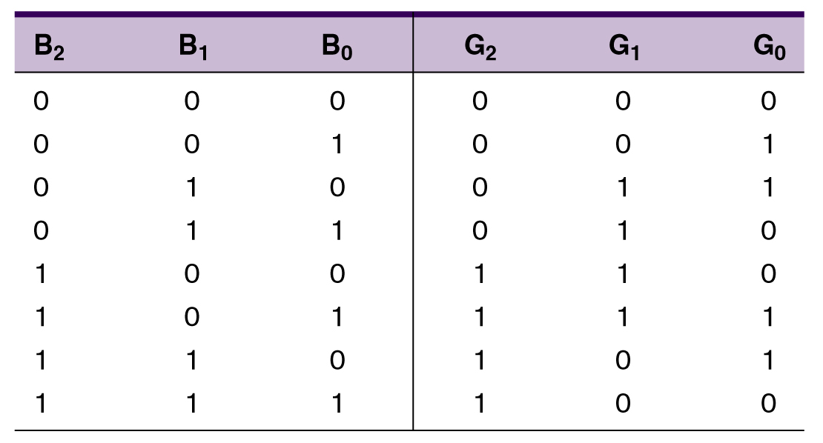
2-5 The Gray Code
The Gray code is used in applications where numbers change rapidly.
Only one bit changes from each value to the next.
Three bit binary and Gray code equivalents.

Slide 25
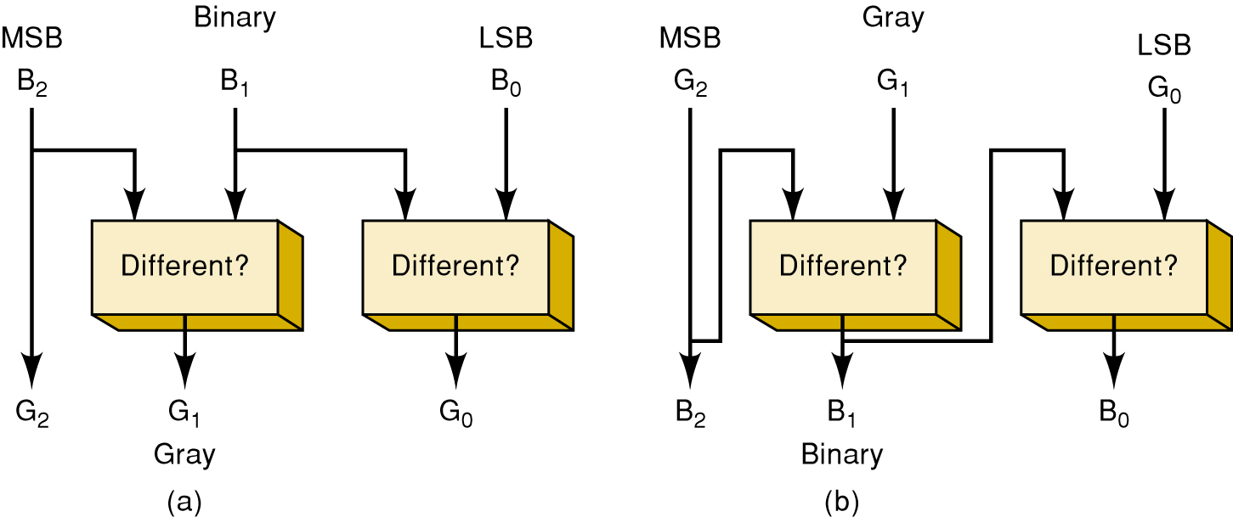
2-5 The Gray Code
Binary to Gray Gray to Binary

Slide 26
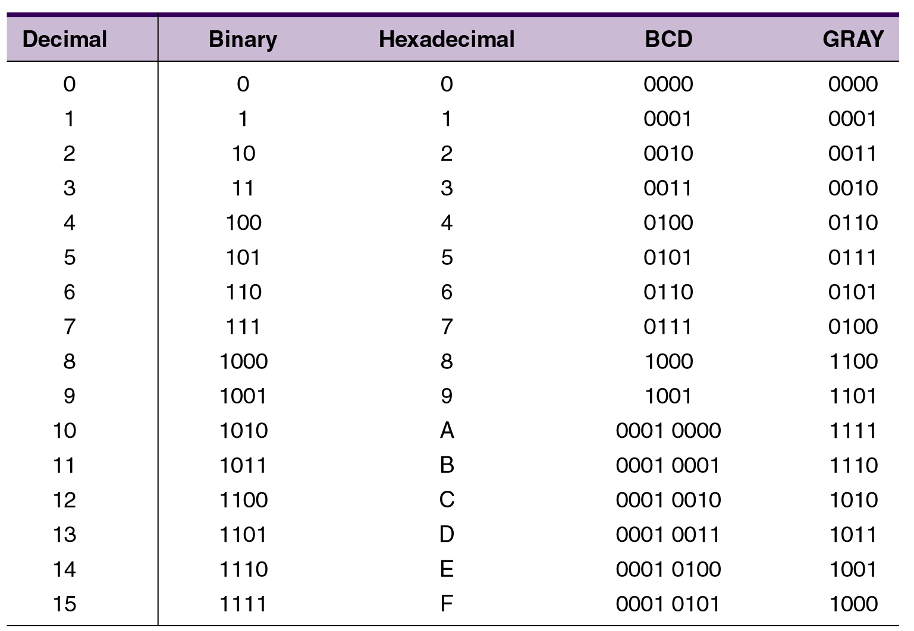
2-6 Putting It All Together
Decimal numbers 1 – 15 in binary, hex, BCD, Gray
Ronald Tocci/Neal Widmer/Gregory Moss Digital Systems: Principles and Applications, 10e

Slide 27
The Byte, Nibble, and Word
Most microcomputers handle and store binary data and information in groups of eight bits.
8 bits = 1 byte.
A byte can represent numerous types of data/information.
Nibble: Binary numbers are often broken into groups of four bits. Because a group of four bits is half as big as a byte, it was named a nibble.
A word is a group of bits that represents a certain unit of information.
Word size can be defined as the number of bits in the binary word a digital system operates on.
PC word size is eight bytes (64 bits) because it can handle 64 bits at a time.
Ronald Tocci/Neal Widmer/Gregory Moss Digital Systems: Principles and Applications, 10e

Slide 28
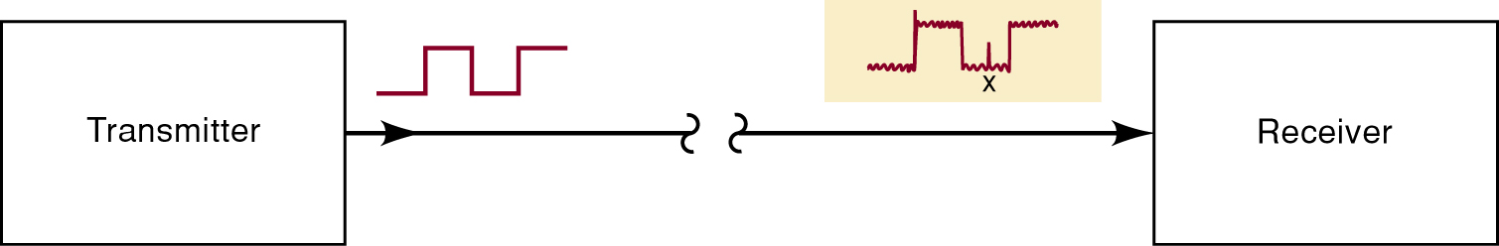
2-9 Parity Method for Error Detection
Electrical noise can cause errors during transmission.
Spurious fluctuations in voltage or current present in all electronic systems.
Many digital systems employ methods for error detection—and sometimes correction.
One of the simplest and most widely used schemes for error detection is the parity method.
Ronald Tocci/Neal Widmer/Gregory Moss Digital Systems: Principles and Applications, 10e

Slide 29
2-9 Parity Method for Error Detection
The parity method of error detection requires the addition of an extra bit to a code group.
Called the parity bit, it can be either a 0 or 1, depending on the number of 1s in the code group.
There are two parity methods, even and odd.
The transmitter and receiver must “agree” on the type of parity checking used.
Even seems to be used more often.
Ronald Tocci/Neal Widmer/Gregory Moss Digital Systems: Principles and Applications, 10e
Copyright ©2007 by Pearson Education, Inc. Columbus, OH 43235 All rights reserved.

Slide 30
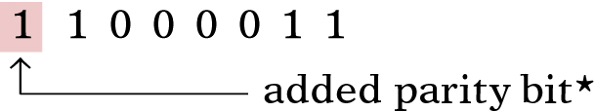
2-9 Parity Method for Error Detection
Even parity method—the total number of bits in a group including the parity bit must add up to an even number.
The binary group 1 0 1 1 would require the addition of a parity bit 1, making the group 1 1 0 1 1.
The parity bit may be added at either end of a group.
Ronald Tocci/Neal Widmer/Gregory Moss Digital Systems: Principles and Applications, 10e

Slide 31
2-9 Parity Method for Error Detection
Odd parity method—the total number of bits in a group including the parity bit must add up to an odd number.
The binary group 1 1 1 1 would require the addition of a parity bit 1, making the group 1 1 1 1 1.
The parity bit becomes a part of the code word.
Adding a parity bit to the seven-bit ASCII code produces an eight-bit code.
Ronald Tocci/Neal Widmer/Gregory Moss Digital Systems: Principles and Applications, 10e

